Slide 1

BIOMETRIC IDENTIFICATION
Evaluating Noise Robustness in Privacy-Preserving Systems
By: Raneem Ibraheem (212920896) & Aseel Nahas (212245096)
Supervised by: Prof. Adi Akavia

Slide 2
BACKGROUND AND MOTIVATION
Biometric Identification: Utilizes unique biological traits (e.g., faces) for identity verification.
Challenges: Privacy concerns when processing data on untrusted platforms.
Solution: Fully Homomorphic Encryption (FHE) enables computations on encrypted data.
Focus: Evaluating the robustness of face-recognition models (VGGFace2) under precision constraints introduced by FHE.

Slide 3
RESEARCH OBJECTIVES
Assess performance degradation in face-recognition models due to limited precision computations.
Explore the feasibility of using the model in privacy-preserving environments.
Provide insights into the accuracy, AUC, and runtime under various precision levels.

Slide 4
TECHNICAL BACKGROUND
Model and Dataset:
Model: VGGFace2 pre-trained on SENet-50.
Dataset: Labeled Faces in the Wild (LFW) with over 13,000 images.
Feature Extraction:
Converts images to 2048-dimensional embeddings.
Embeddings represent unique facial features.

Slide 5
TECHNICAL BACKGROUND
Key Metrics:
Similarity Metrics:
Euclidean Distance.
Cosine Similarity.
Precision Truncation:
Rounds embeddings to simulate FHE-induced noise.
Precision levels range from 0 to 10 decimal places.
Performance Metrics:
Accuracy (% of correct matches).
AUC (area under ROC curve).

Slide 6
IMPLEMENTATION DETAILS
System Architecture:
Workflow:
Load Data: Preprocess images from LFW.
Feature Extraction: Generate embeddings with VGGFace2.
Similarity Computation: Compare embedding pairs.
Truncation: Simulate noise with limited precision.
Classification: Train a dense neural network to classify pairs.
Evaluation: Measure accuracy, AUC, and runtime.

Slide 7
IMPLEMENTATION DETAILS
Key Techniques:
Data Augmentation: Rotation, zoom, brightness adjustments.
Loss Function: Focal loss to handle class imbalance.
Optimization: Adam optimizer with learning rate scheduling.

Slide 8
RESULTS
Performance Overview:
Accuracy:
Full precision: 97.21%.
Integer precision: 97.19%.
Across all levels: consistently above 97%.
AUC:
Full precision: 99.67%.
Integer precision: 99.68%.
Across all levels: consistently above 99.66%.

Slide 9
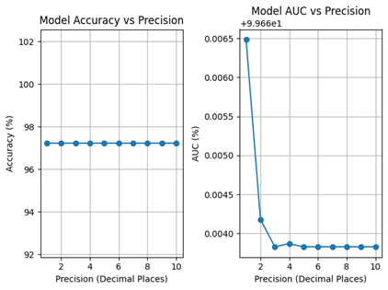
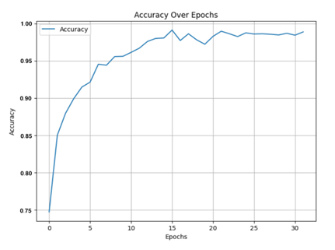
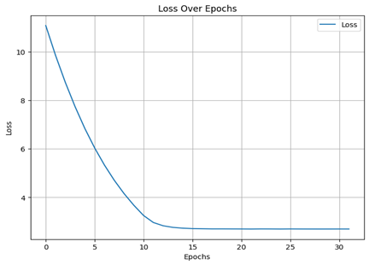
RESULTS
Visual Insights:
Accuracy vs. Precision graph
Accuracy over epochs
Loss over epochs

Slide 10
DISCUSSION
Key Findings:
Robustness: Model maintains high accuracy/AUC under precision constraints.
Feasibility: Suitable for privacy-preserving settings using FHE.
Future Work:
Test on diverse datasets and adversarial scenarios.
Explore other encryption methods with lower noise.

Slide 11
CONCLUSION
Takeaways:
Demonstrated robustness of biometric identification under precision constraints.
Found high accuracy (97%+) and AUC (99%+) across all levels.
Validated the system's applicability in secure, privacy-preserving environments.

Slide 12
REFERENCES
Acknowledgments and Citations:
University of haifa materials, 2024. Accessed during the course Deep Learning at University of Haifa.
Q. Cao, L. Shen, W. Xie, O. M. Parkhi, and A. Zisserman. Vggface2: A dataset for recognizing faces across pose and age. In 13th IEEE International Conference on Automatic Face & Gesture Recognition, pages 67–74, 2018.
Ian Goodfellow, Yoshua Bengio, and Aaron Courville. Deep Learning. MIT Press, 2016. http://www.deeplearningbook.org.
Gary B. Huang, Manu Ramesh, Tamara Berg, and Erik Learned-Miller. Labeled faces in the wild: A database for studying face recognition in unconstrained environments. Technical Report 07-49, University of Massachusetts, Amherst, October 2007.
J.-W. Lee et al. Privacy-preserving machine learning with fully homomorphic encryption for deep neural network. IEEE Access, 10:30039–30054, 2022.
Steven Veenma. Face recognition using vggface2 and lfw dataset, n.d. GitHub Repository.

